Slide 1
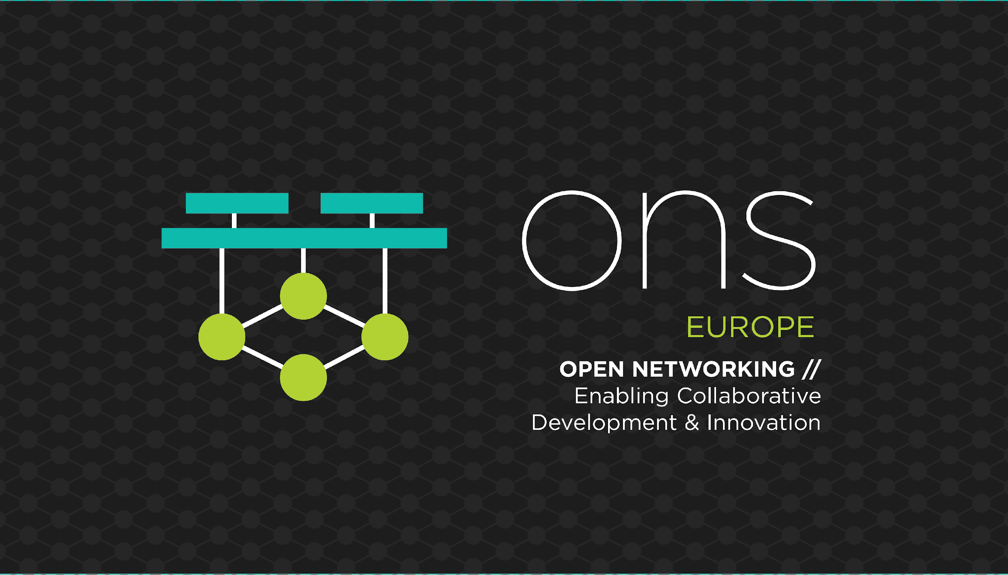

Slide 2

EVPN Networking between Kubernetes Containers and OpenStack VMs
- Vyshakh Krishnan C H (Rtbrick)
- Faseela K (Ericsson)

Slide 3
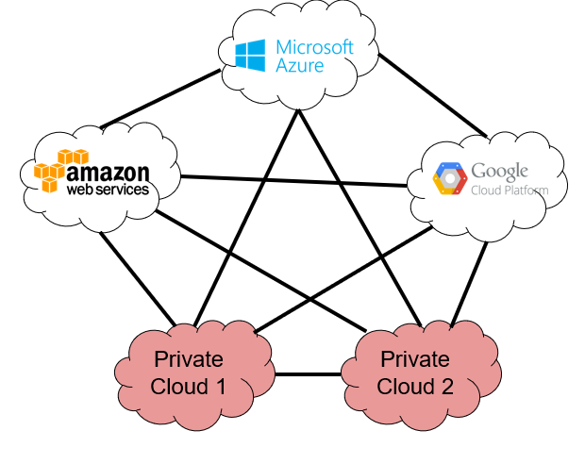
Hybrid/Multi-Cloud Goals
Connectivity
From anywhere to anywhere
Workloads
Can be deployed anywhere
Moved anywhere
Any time
Secure
Dynamic
Fully Automated

Slide 4
ODL Netvirt project Ecosystem
ODL
Modular framework (MD-SAL) which enables quick and seamless integration between any components via well-defined YANG interfaces
Strong support in platform and architecture for HA and resiliency
NetVirt
ODL Netvirt is a cloud networking provider service
Full integration with Openstack Neutron & Kubernetes
Dataplane integration with OVS using Openflow and OVSDB
Provides distributed dataplane forwarding capabilities between virtualized endpoints

Slide 5
ODL Netvirt project Ecosystem
NetVirt
Provides connectivity to legacy L2 domains and bare-metal servers via HWVTEP integration
Fully distributed E-W L3 dataplane forwarding
Security groups support
IPv6 control plane and dataplane support
Multiple options for N-S/DCI connectivity including
VLAN provider based connectivity to the DC-GW
L3VPN DCI connectivity to the WAN
L3VPN North-South connectivity to external networks with NAT support
EVPN based connectivity for L2 and L3 DCI

Slide 6
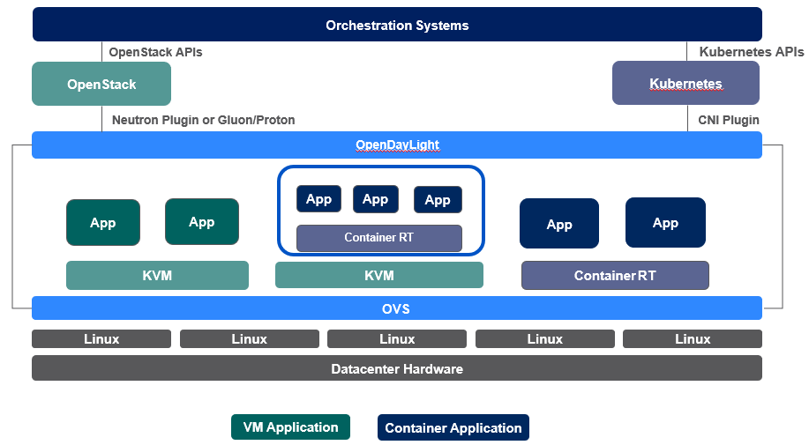
ARCHITECTURE

Slide 7
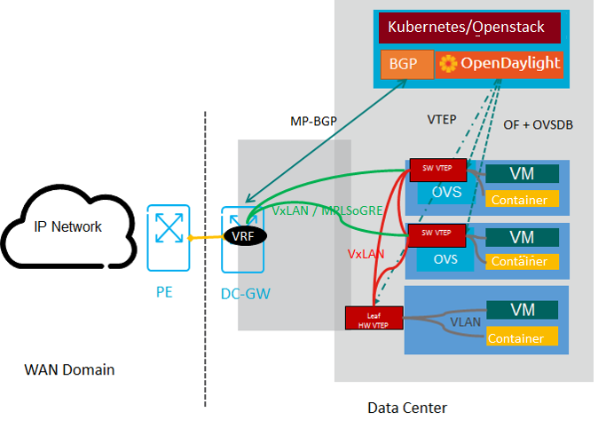
ODL DCI Deployment Model

Slide 8
EVPN
MP-BGP based control plane to exchange rich set of data between peers
Exchange MAC and IP of hosts using RT-2 routes
Exchange of IP prefixes using RT-5 routes
ARP suppression can be enabled in VTEPs to prevent ARPs getting flooded over VxLAN tunnels, locally and remotely
Nodes can be configured for symmetric IRB (using a common L3VNI) or asymmetric IRB (using the destination network VNI)
Multi-homing, multicast route support
Mass route withdrawal (RT-1)
RFC 7432 - BGP MPLS based EVPN
draft-ietf-bess-evpn-overlay - EVPN support for VxLAN dataplane

Slide 9
ODL EVPN Implementation
Configuration of VPN instance (EVI), RD’s and RT’s via Openstack BGPVPN service plugin
Single BGP session managed by ODL, which advertises all prefixes on behalf of all VMs connected to vSwitches in each EVI
Enables single-hop connectivity in the dataplane between vSwitch hosting the VM, and DC-GW
For an L3 DCI use case, ODL advertises host-routes (/32) using RT-5 for VM prefixes with OVS TEP IPs as next-hops.

Slide 10
ODL EVPN Implementation
For an L2DCI use case, ODL exchanges MACs + IPs of VM endpoints with OVS TEP IPs as next-hops using RT-2
Subnet routes are also advertised for RT-5 to enable connectivity to silent hosts
Support asymmetric as well as symmetric IRB
Asymmetric IRB based forwarding used for OVS to OVS distributed forwarding model
Symmetric IRB based L3 between OVS and DC-GW
The DC-GW needs to stitch vrf’s in the DC (EVPN) with WAN (L3VPN or EVPN) domains by re-originating route prefixes
BUM traffic (if needed) is forwarded using HER

Slide 11
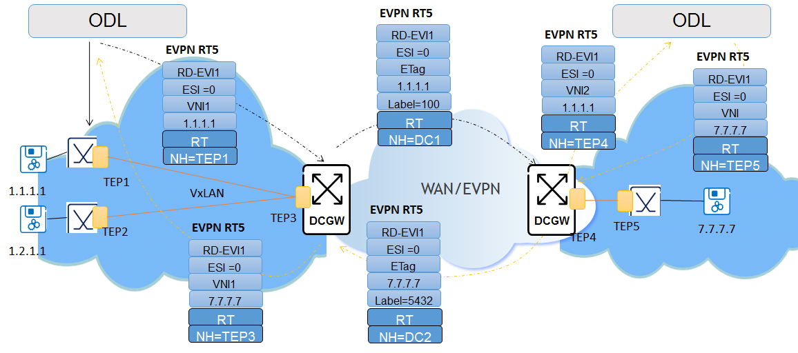
L3 DCI

Slide 12
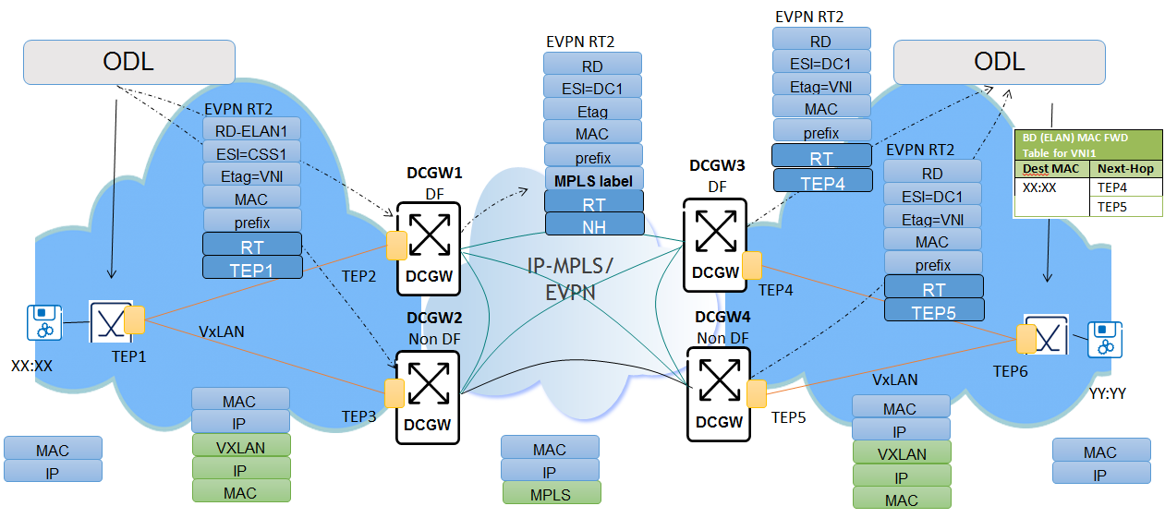
L2 DCI

Slide 13
DEMO

Slide 14
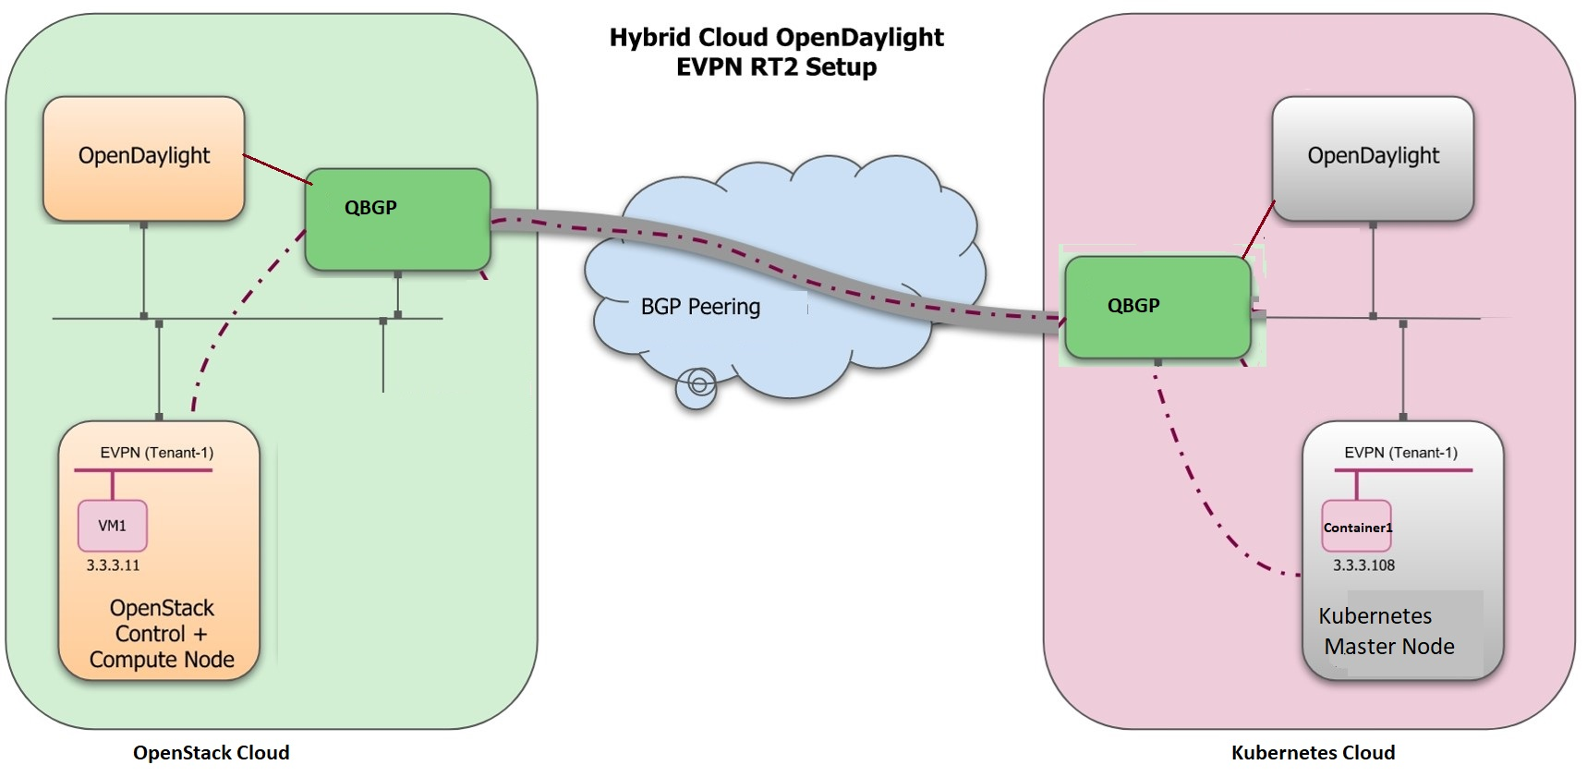

Slide 15
Future Scope
<Add if any plans>

Slide 16
Questions?

